Slide 1


Business Analytics Creative Activity
ACSSM Data Quality Project
Xianghe Xu (Michael)

Slide 2

The Australian Comparative Study of Survey Method (ACSSM)
Conducted by Social Research Center, in December 2022
Evaluate contemporary and emerging practices for general population surveys
The purpose of this study is to compare performance of survey methods
Include eight parallel surveys of the Australian adult population using five different survey methods
Probability based panels VS Non-Probability based panels
VALI
Life in Australia
CATI
SMS push to web
Panel 1
Panel 2
Panel 3
Panel 4
Objectives:
To compare quality of the survey data
&
Evidence supporting the hypothesis that non-probability-based panels have worse data quality compared to probability-based panels.

Slide 3
Survey Data Quality
Student Evaluation of Teaching and Units (SETU)
Student Experience Survey (QILT)
Incentives:
Asked by teachers
Avoid email / text bombing
Enter a prize draw
Money
Careless respondents / Insufficient effort respondents

Slide 4
Metrics
Analysis of response quality using available response metrics
Response time analysis
Straight lining
Consistency approach
Outlier Analysis
Item non-response
Bogus item
Mid-point selection
Mahalanobis Distance
Polytomous Guttman errors
More…
In practice:
Definitions of the metrics
Implementations of the metrics
Limitations of the metrics
Connect to survey data, with 189 variable
Apply metrics to suitable variables
Decision Rules
Compare result
Response time analysis
Straight lining
Consistency approach
Outlier Analysis
Item non-response
Bogus item
Mid-point selection
Mahalanobis Distance
Polytomous Guttman errors
Apply each metrics separately to different parts of the ACSSM dataset
Use result to compare the methods within the dataset

Slide 5
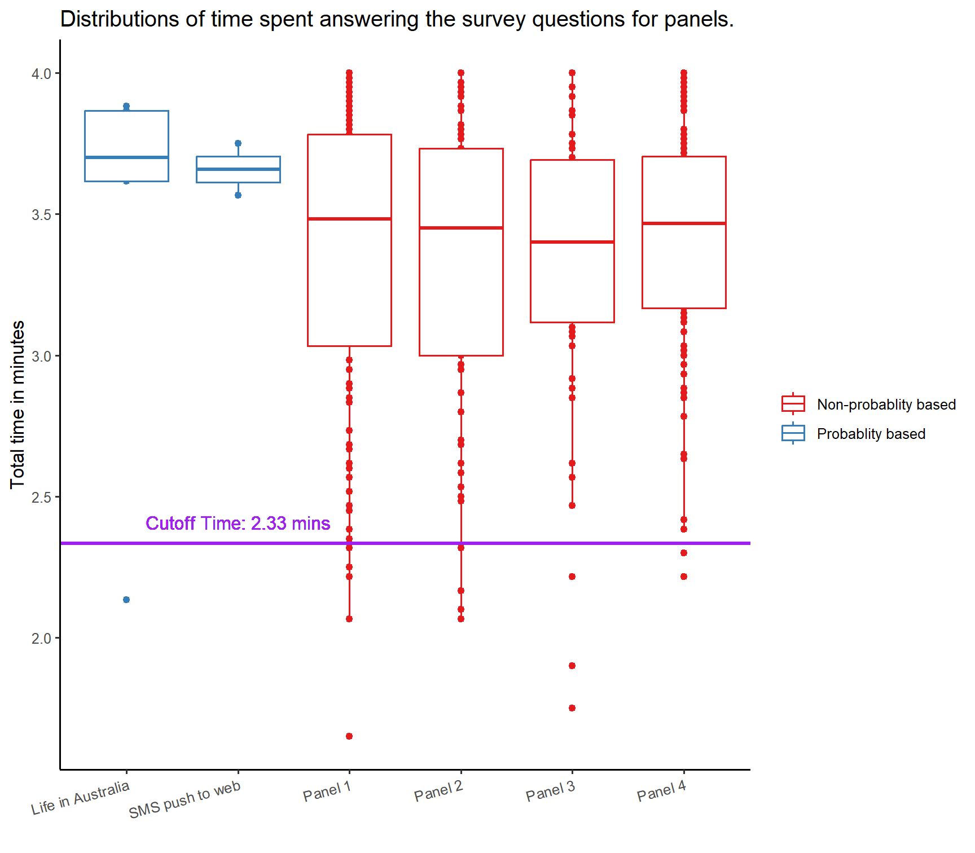

Response Time Analysis (Speeding)
An analysis of the time taken to complete a survey or answer all survey questions.
Short time

Slide 6
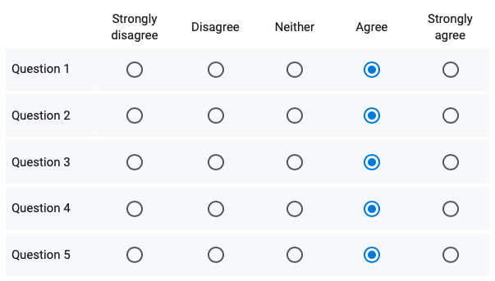
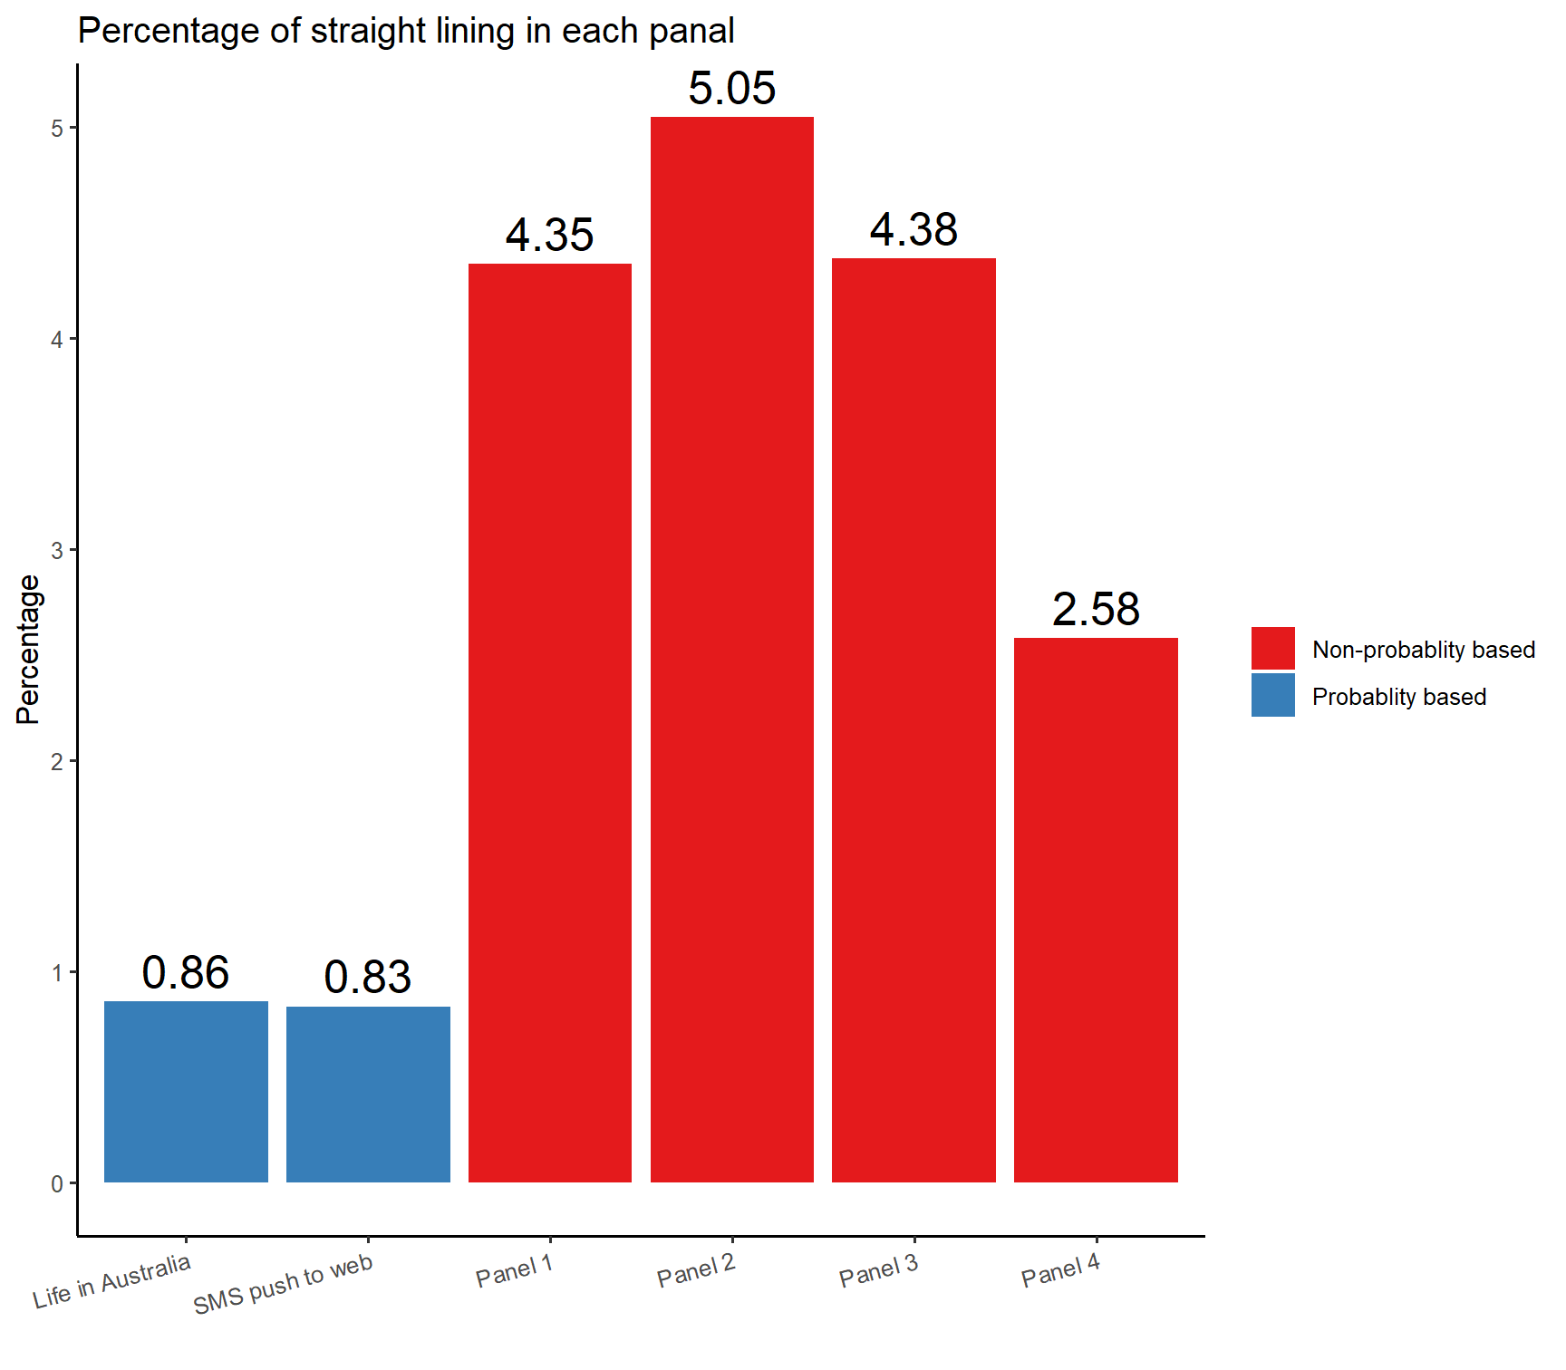
Straight lining
Refers to the tendency of respondents to choose the same or a very similar answer option for each item in a grid.
= insufficient effort responding

Slide 7
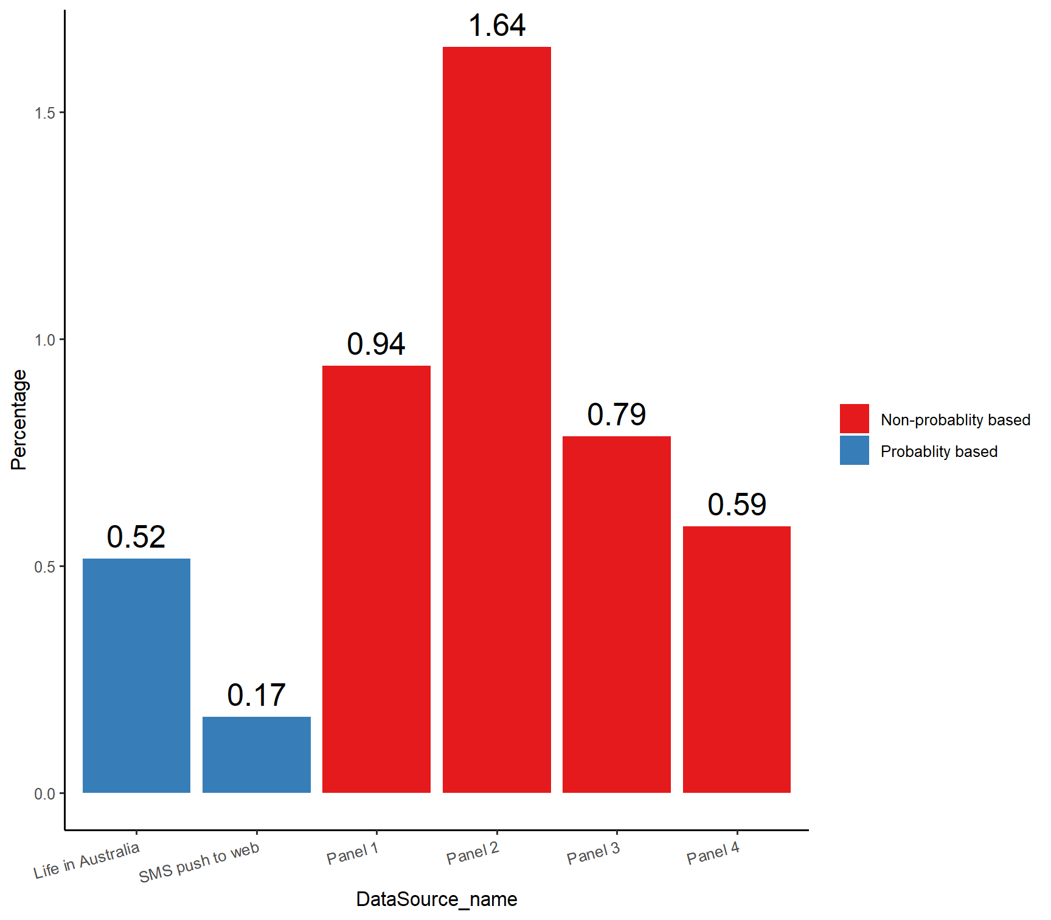
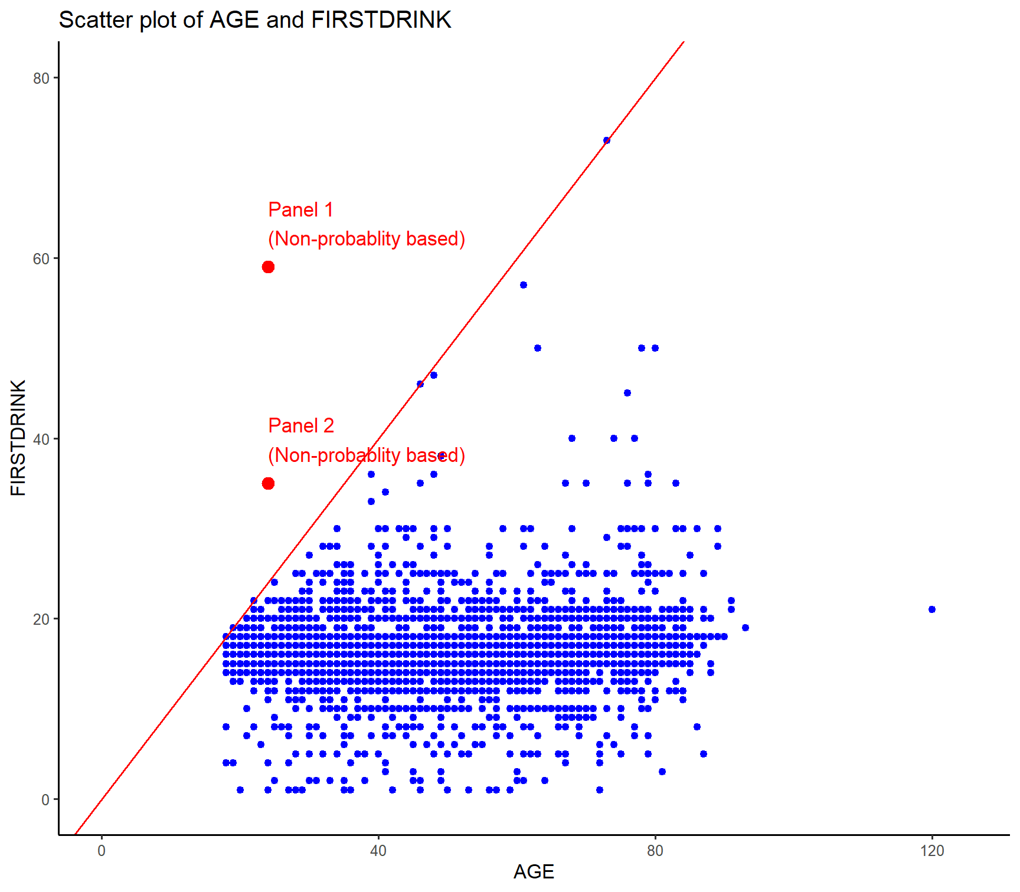
Consistency Approach
AGE :Current age
FIRSTDRINK : Age of first-time alcohol beverage consumption.
AGE >= FIRSTDRINK
- Check consistency of responses within an individual
- Find matched item pairs
- Compares the responses
- Use logical link

Slide 8
RESULT
More careless respondents existing in non-probability based panels
Evidence that non-probability based methods exhibit worse data quality.

Slide 9

THANK YOU!
Q & A

Slide 10
END!

Slide 11
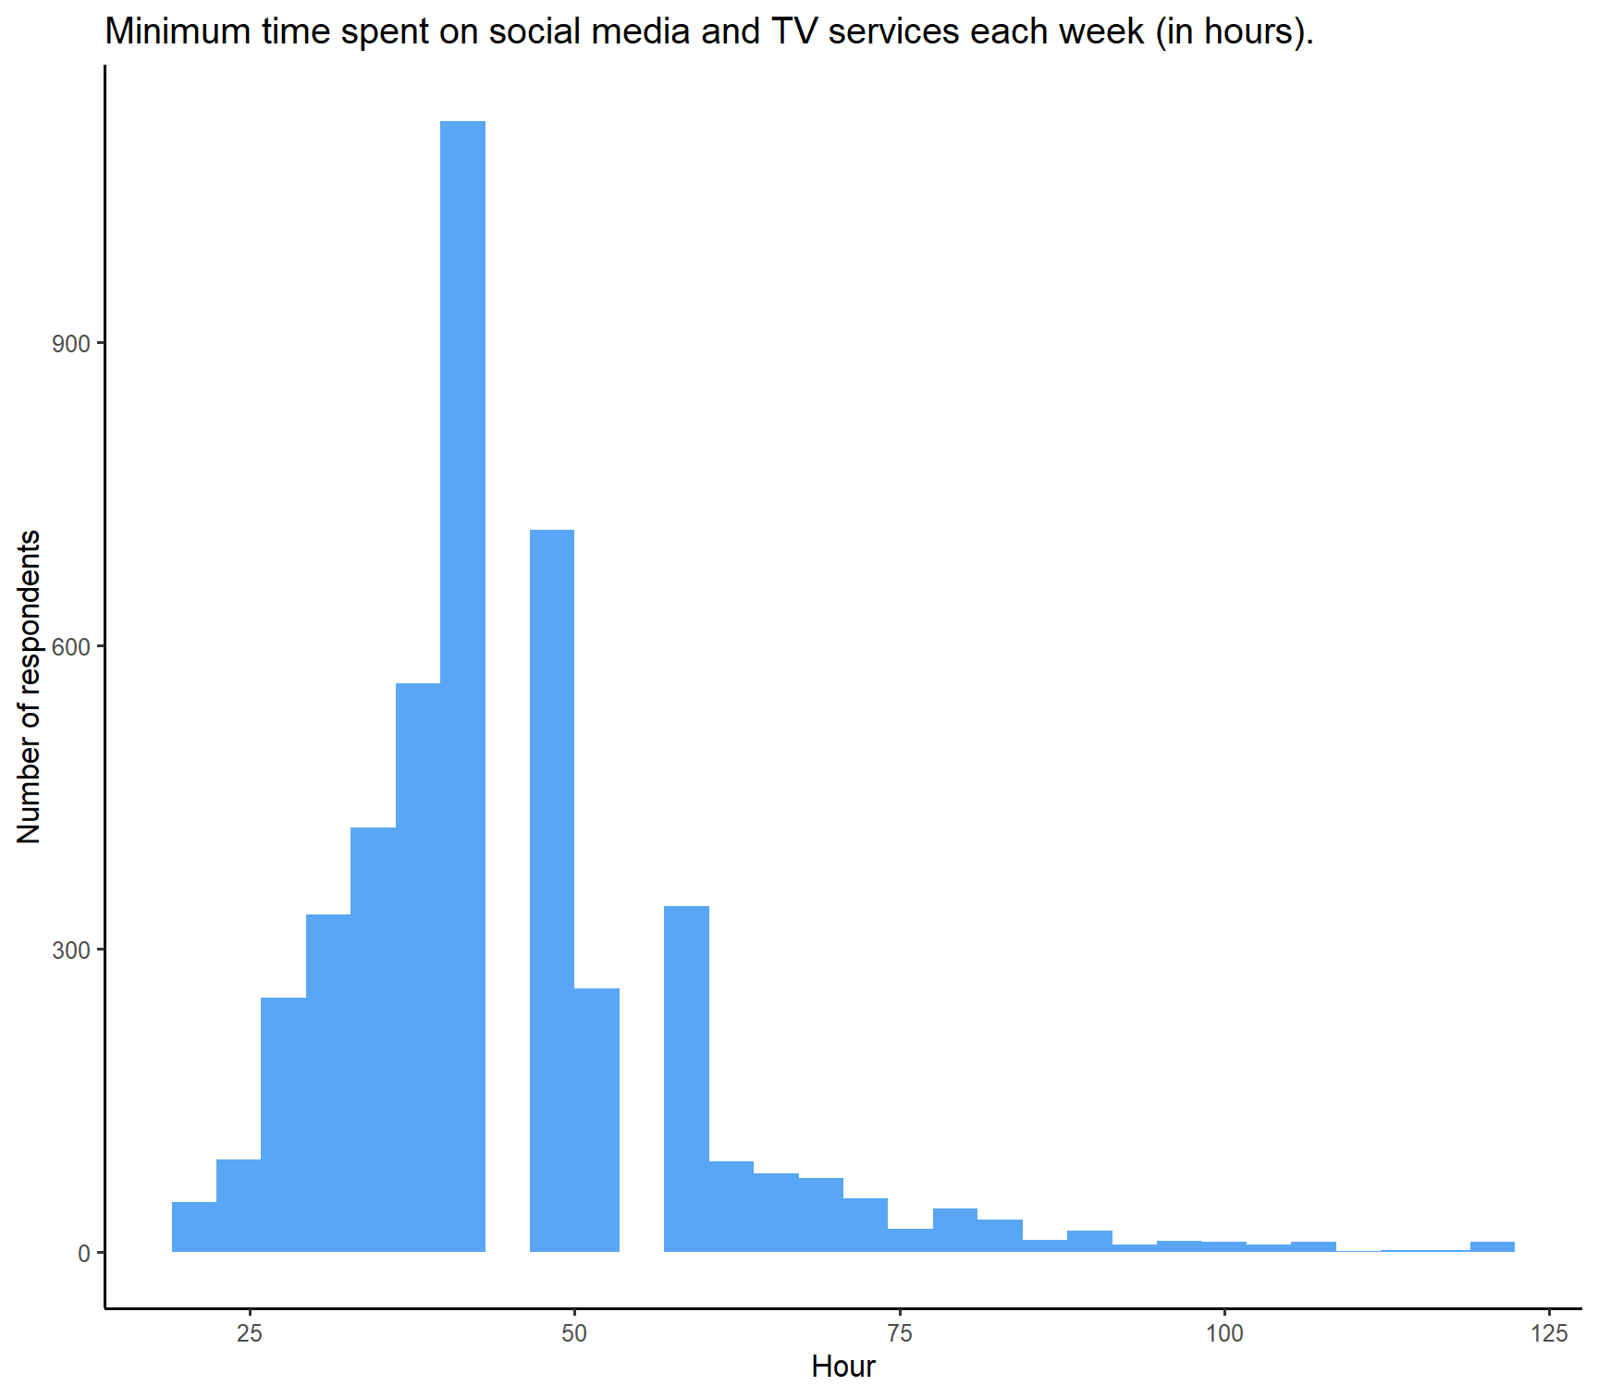
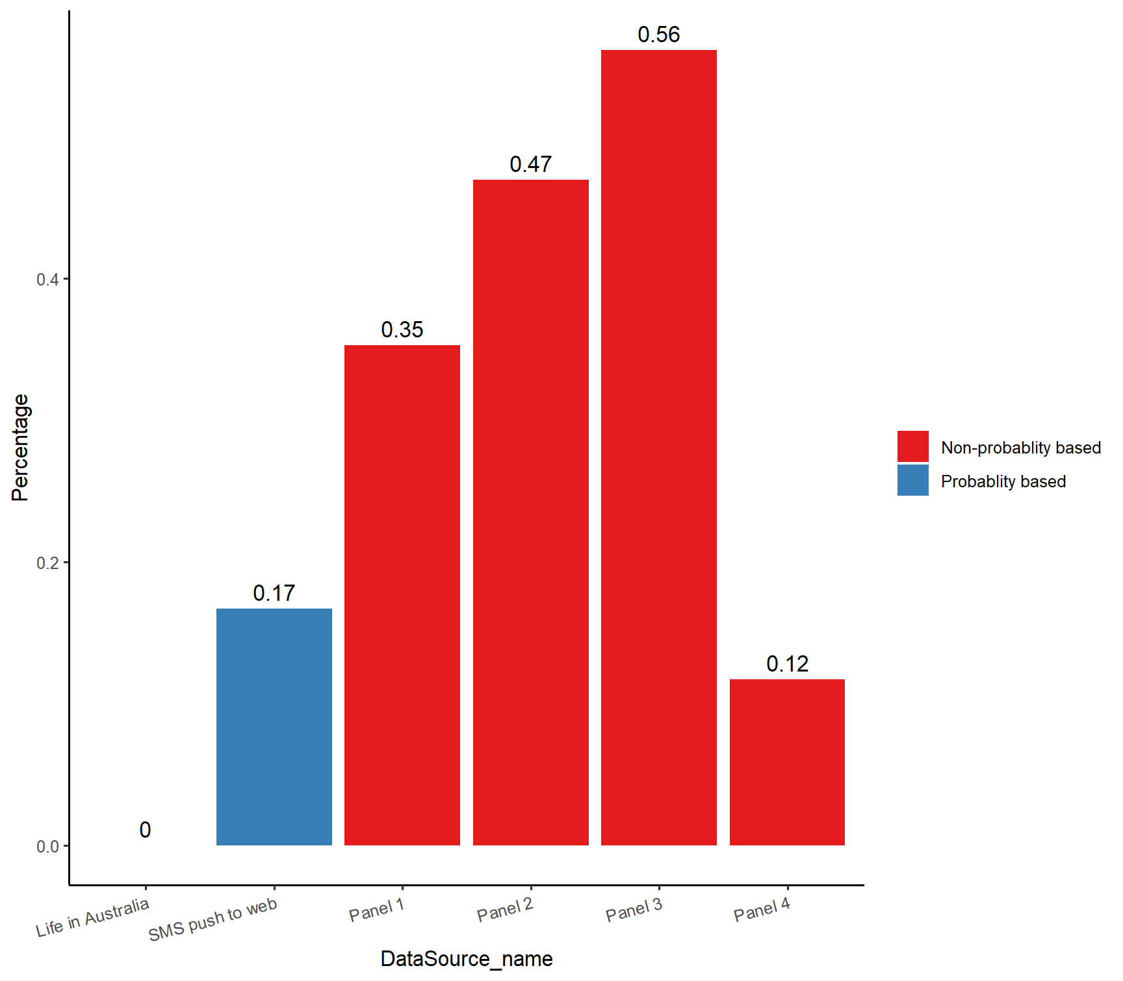
Outlier Analysis
Unusual data point relative to the remainder of a distribution.
Respond without sufficient effort are likely to differ from majority responses
14 observations
120 + hours / week

Slide 12
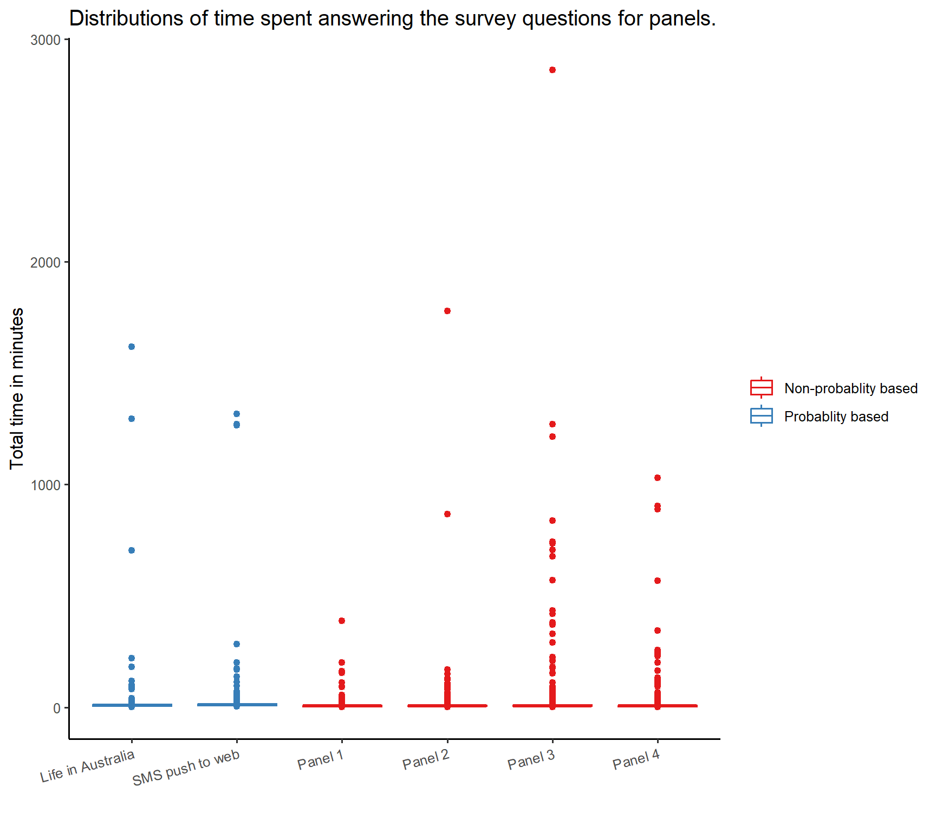

Slide 13
